Slide 1
Bullet Hell Dungeon
Jonathan Sarasua

Slide 2


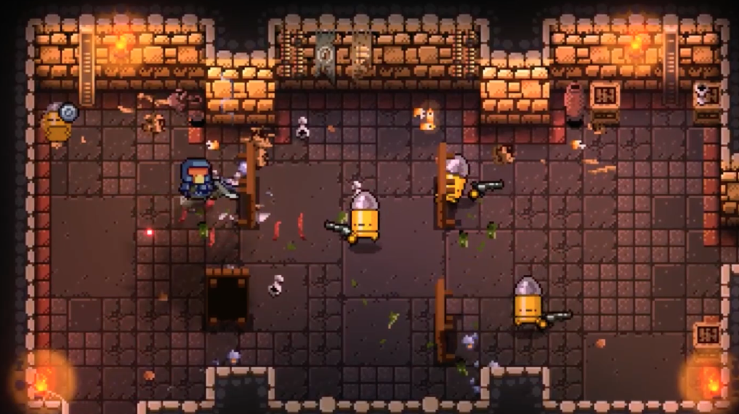
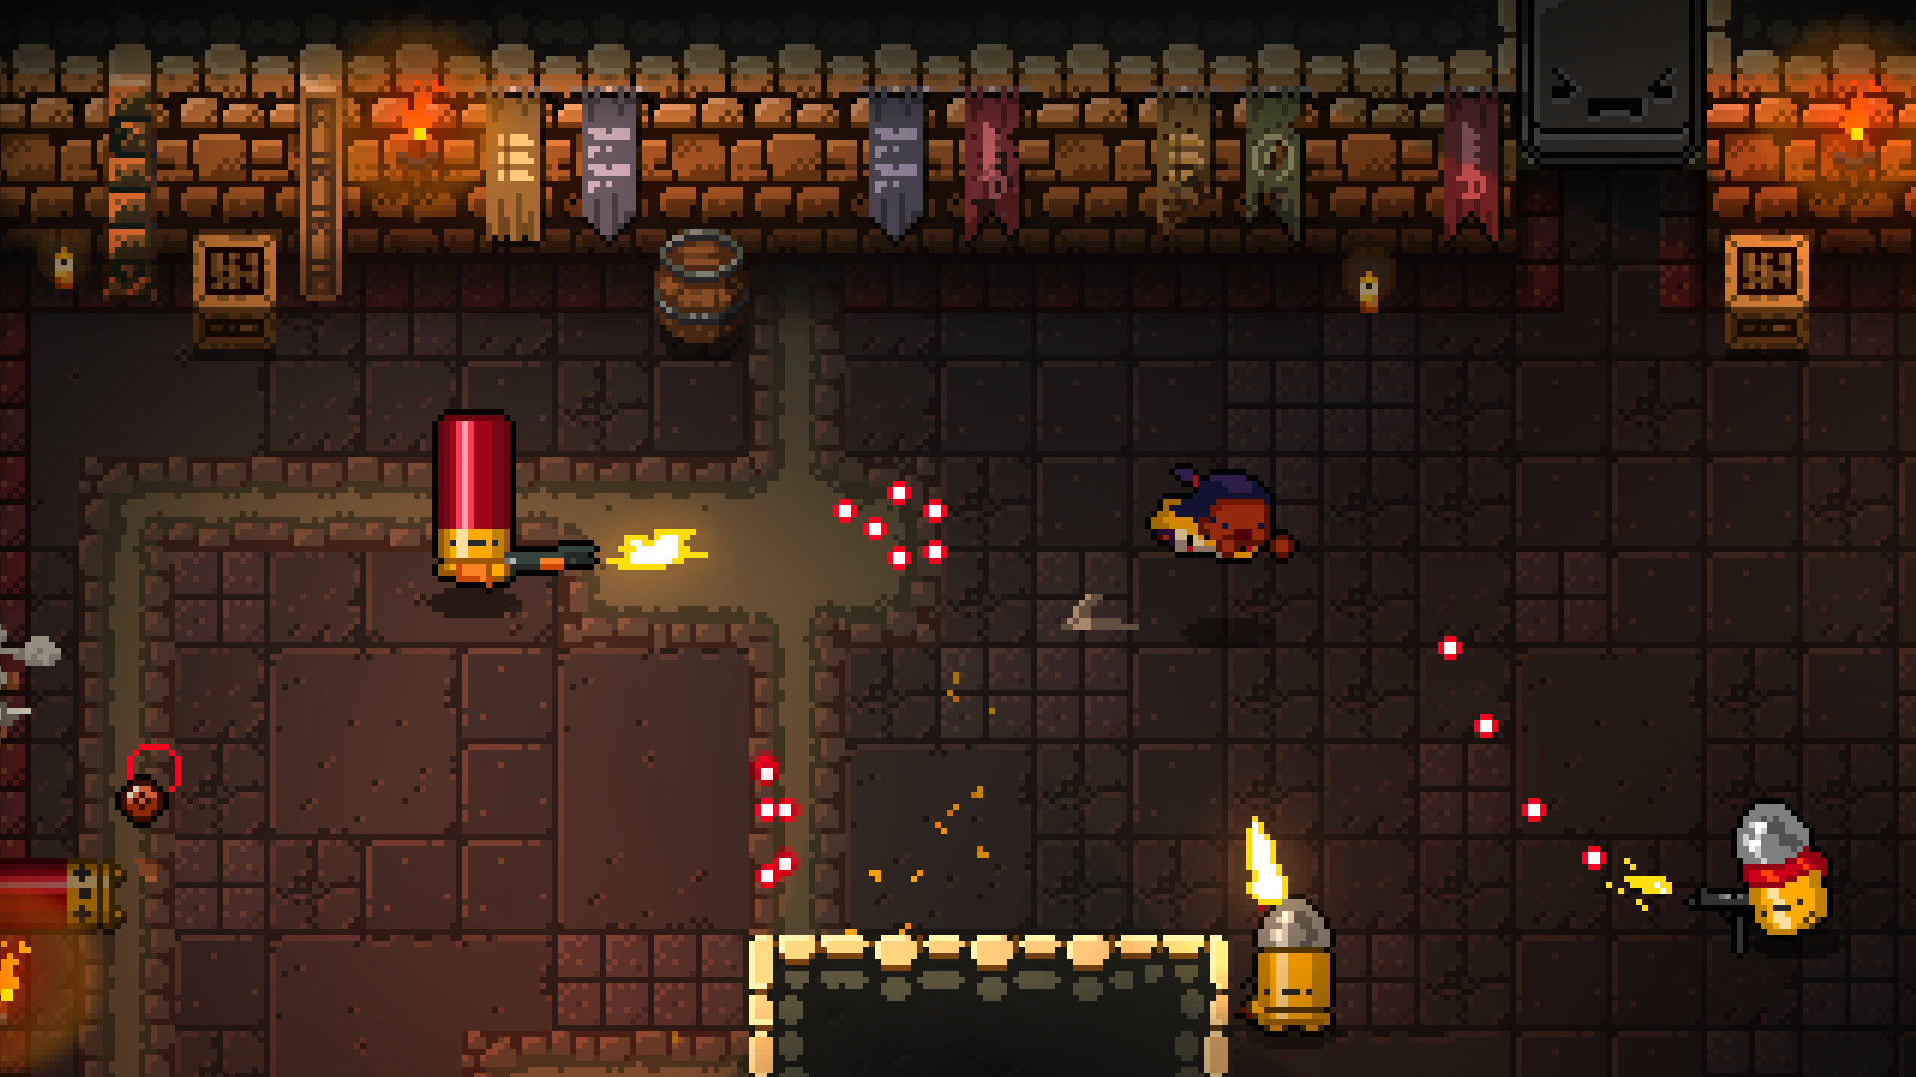
Gameplay
Lots of bullets
Lots of guns
Somehow dodge everything
Win
Incursion on Super Steroids
This Photo by Unknown Author is licensed under CC BY-SA-NC
This Photo by Unknown Author is licensed under CC BY-SA-NC

Slide 3
Milestones
Milestone 1
Create the data driven actors, weapons, bullets, etc. and allow the player to walk around and shoot
Focus on building architecture
Milestone 2
Build out first playable level with smarter AI and a final boss
Implement a HUD and dodge mechanic
Milestone 3
Add audio to everything
Finish out maps and add weapons
Add transitions for death, completing levels, etc.
Final deliverable
Fix everything
Polish

